Slide 1

Let me talk to
CLIVE
Team 8 - Track 1
Anaïs BAYANI, Agathe COUTAUX, Isaline GOUDEAU, Baptiste MOALIC, Anicet NOUGARET

Slide 2
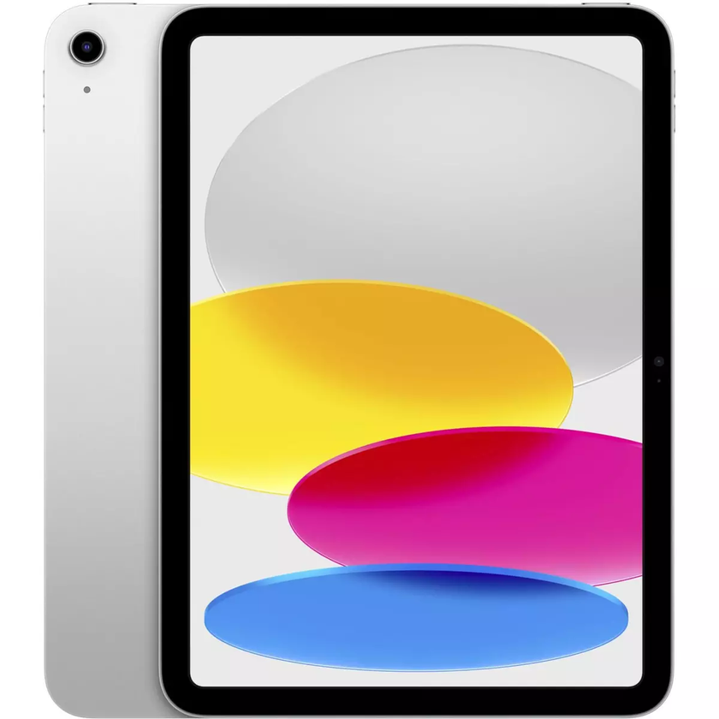
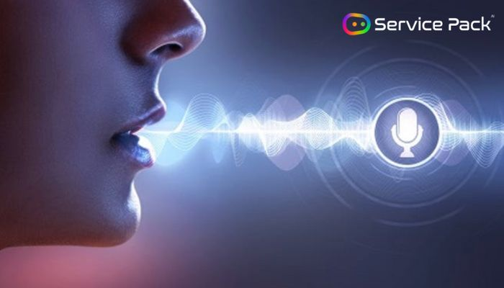



THE ULTIMATE SMART ASSISTANT
100%-offline
100% privacy
Directly available on your computer

Slide 3
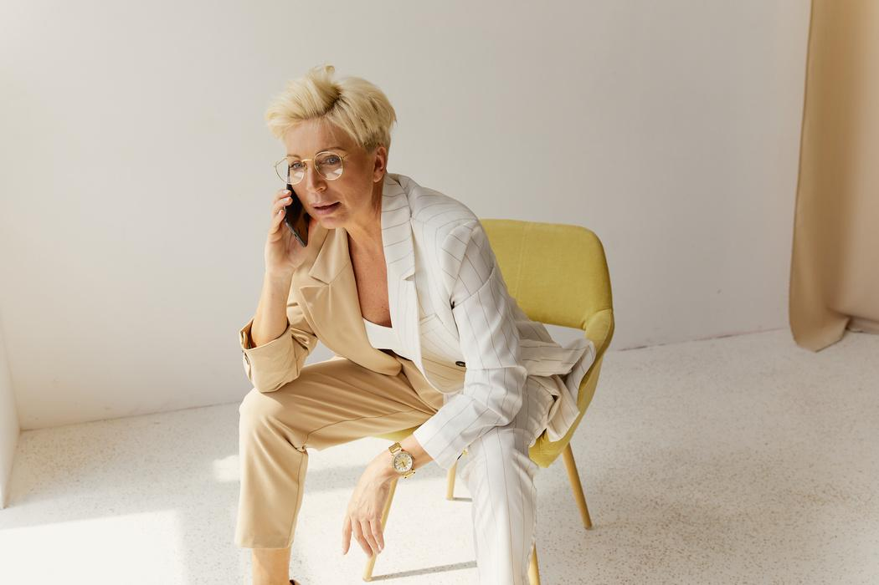
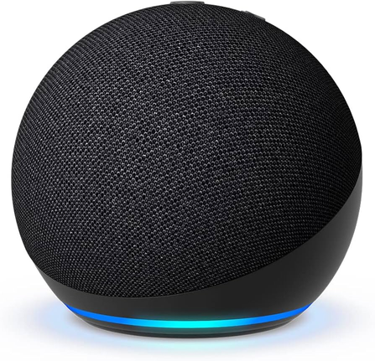


120 M€ Turnover in y+3
120 M€
Turnover in Y3
Voice-assistant user
(20 to 50 years old - middle-class - US Market)
Alexa Market
100 M users
5€/Months/user
2% of Alexa Users
60€ / years
2M users in Y3

Slide 4
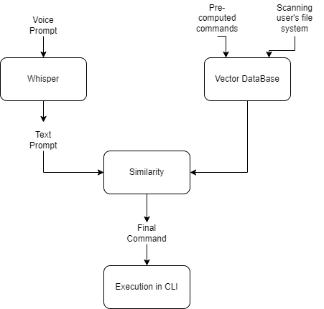
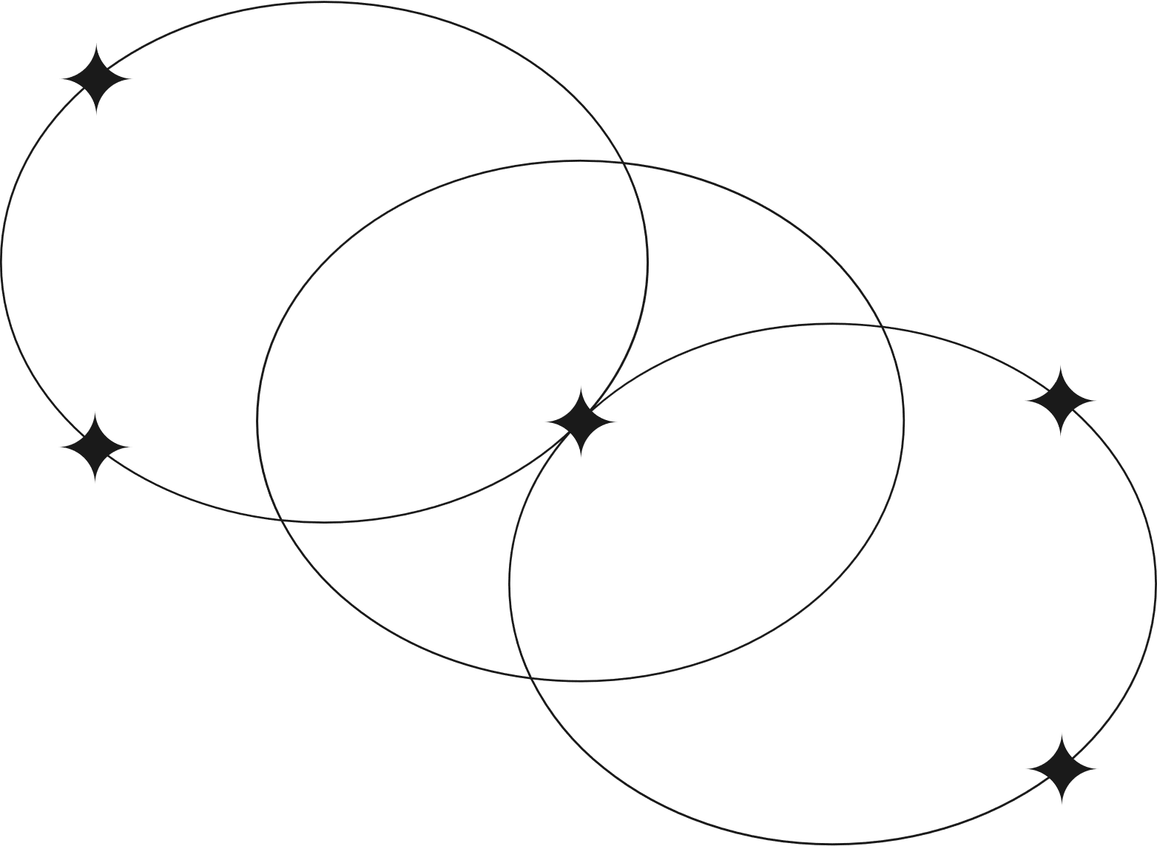
A smooth edge-AI solution adapted to every device

